Slide 1
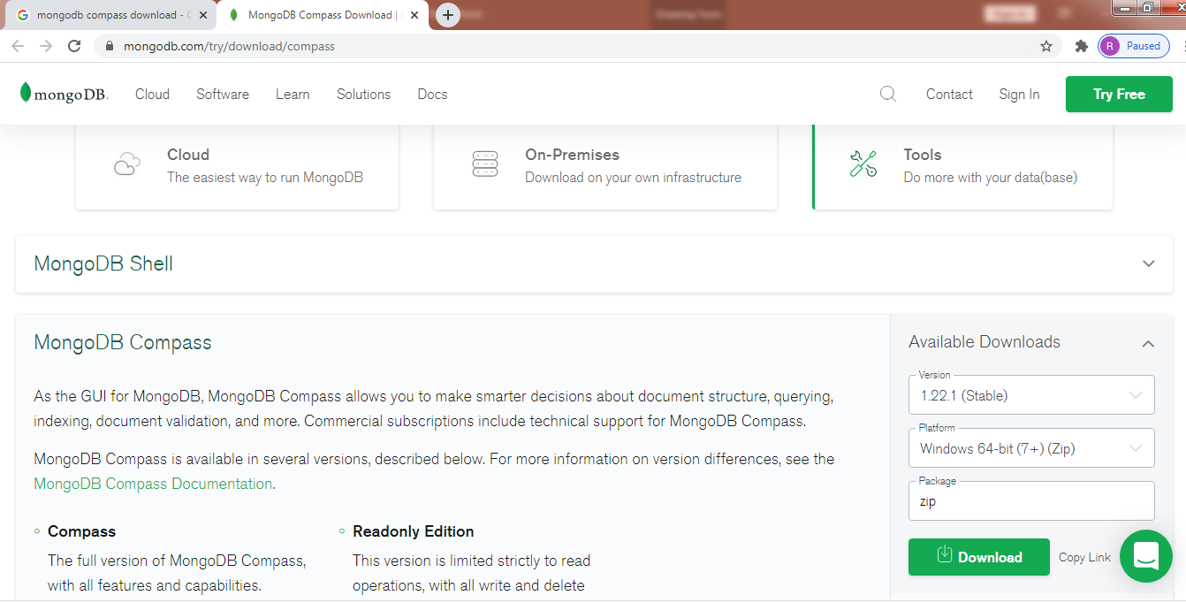
Install Mongo compass On Windows
https://www.mongodb.com/try/download/compass

